Slide 1
Revisiting the Kernel Security Enhancements in iOS 10
MOSEC 2017
Liang Chen @ Tencent Keen Lab

Slide 2

Last year in iOS 10
2016.6.13 first iOS 10.0 beta was released
    2016.7 Pangu team released iOS 9.3.3 jailbreak. Why?
    2016.8 First iOS APT, Pegasus, was observed
2016.9.13 first release version of iOS 10 was out
2016.10.24 iOS 10.1 was released
    2016.10.25, Keen Lab pwned iOS 10.1 twice in Pwn2Own(remotely stealing photos, remotely install bogus app

Slide 3
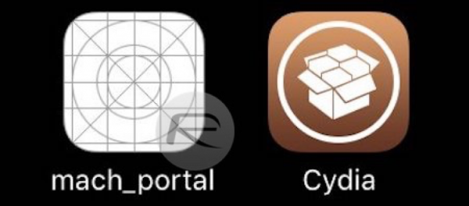
Last year in iOS 10 (cont.)
2016.12.12 iOS 10.2 was released
    Ian Beer of Google Project Zero released mach_portal exploit with a nice write-up
    Luca Todesco released Yalu + mach_portal, Jailbreak on iOS 10.1.1 (including iPhone 7 AMCC bypass)
    Yalu102 (by Luca Todesco and Marco Grassi)
2017.3.27 iOS 10.3 was released
    Everything became quite after that
Question: What happened in this year?

Slide 4
Agenda
Vulnerability
Mechanism
Exploitation
Summary

Slide 5
Part I: Vulnerability

Slide 6
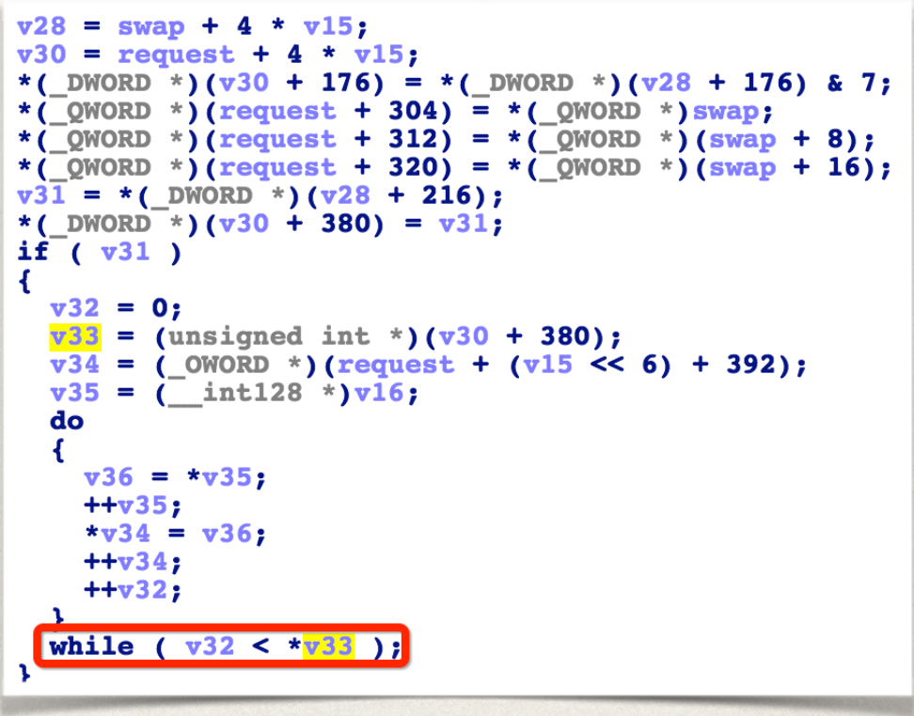
Begin with Pangu 9.3.3…
CVE-2016-4654: Heap overflow in IOMobileFramebufferUserClient
In the 5th methodCall of IOMobileFramebufferUserClient(IOMobileFramebuffer::swap_submit)

Slide 7
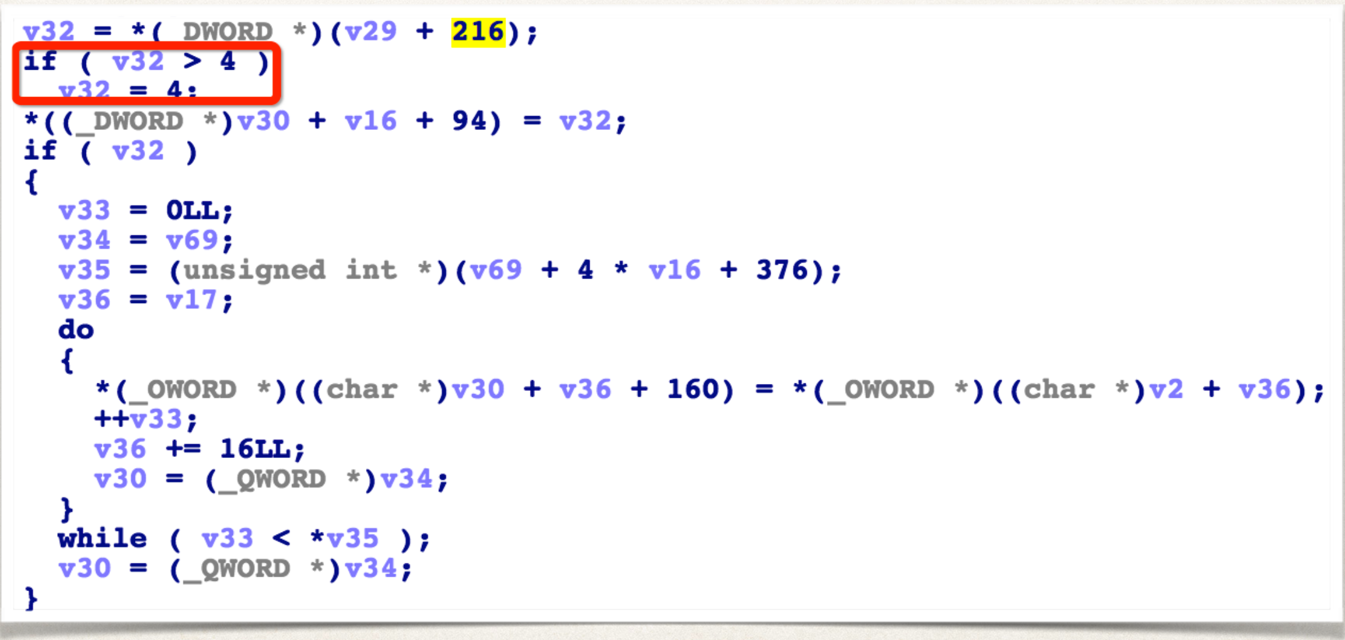
CVE-2016-4654: the fix
Fixed in iOS 10.0 beta 2
someCount cannot exceed 4
We can get conclusion:
    Before iOS 10.0.1 release, Apple made strict audit on iOS 9 code
    Several unfixed bugs were patched in iOS 10 beta
someCount not exceed 4

Slide 8
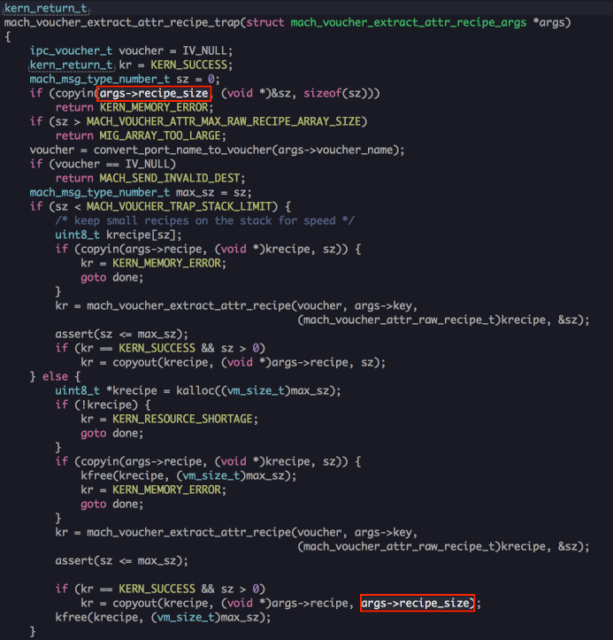
XNU case: CVE-2017-2370
Discovered by Marco Grassi of Keen Lab, bug collision with Ian Beer later on
Heap overflow in mach_voucher_extract_attr_recipe
    args->recipe_size is a userland pointer pointing to the size value
    args->recipe_size is used as size value here

Slide 9
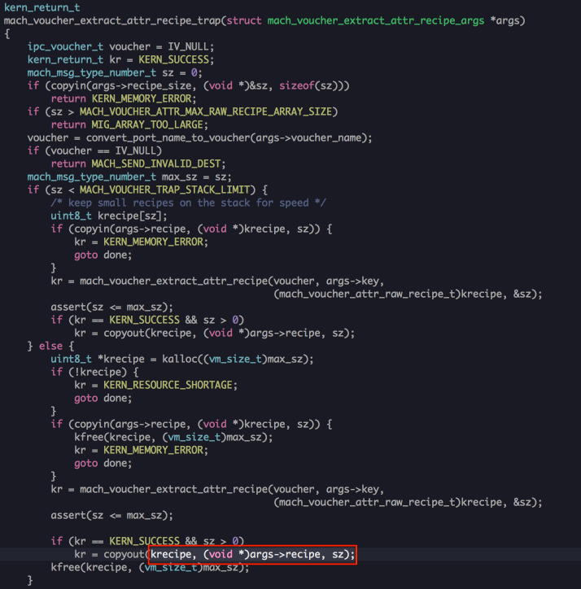
CVE-2017-2370: the fix
Fixed in iOS 10.2.1
Lesson learned
    Newly added interfaces or features are more likely to be vulnerable
    Length of copyout is changed to sz (correct value)

Slide 10
Part II: Mechanism

Slide 11
Story of OSNumber: From Pegasus
CVE-2016-4655 kernel stack info leak
OSUnserializeXML receives data from userland, and deserialize into basic data structure in kernelland (E.g OSDictionary, OSArray)
OSUnserializeXML receives two kind of XML data
    Binary mode
    XML mode

Slide 12
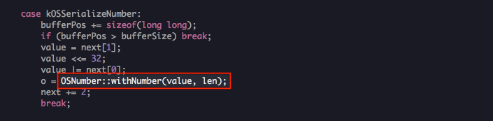
Story of OSNumber: CVE-2016-4655 details
When binary mode is used, OSUnserializeBinary is called to parse the data
    len is user controllable
    value is 64bit in max

Slide 13
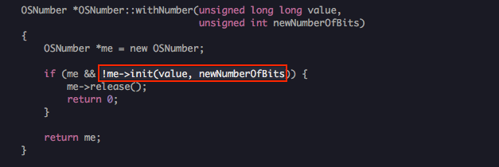
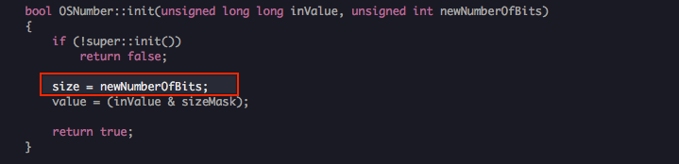
Story of OSNumber: CVE-2016-4655 details
    newNumberOfBits is user controllable
    Size can be set to arbitrary value, but value is 64bit in max (8 bytes)

Slide 14
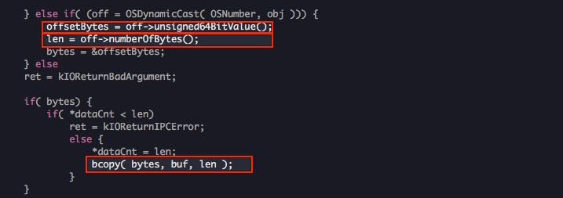
Story of OSNumber: CVE-2016-4655 details
How to leak?
is_io_registry_entry_get_property_bytes
    offsetBytes takes 8 byte memory on stack
    Len is user controllable
    OOB read arbitrary bytes of memory on stack

Slide 15
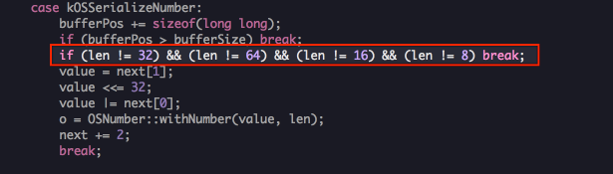
CVE-2016-4655: the fix
Fixed in iOS 10.0.1
In OSUnserializeBinary, only numbers of 8 bits, 16 bits, 32 bits and 64 bits are valid
Apparently not the standard approach to fix. But for iOS , it might be enough
    Only allow numbers of 4 modes

Slide 16
OSNumber: any more problems
OSUnserializeXML receives two kind of XML data…
Binary mode fixed
Try XML mode
    <integer size="100">0X41414141</integer>
Conclusion: iOS 10.0.1 was once again successfully leaked!

Slide 17
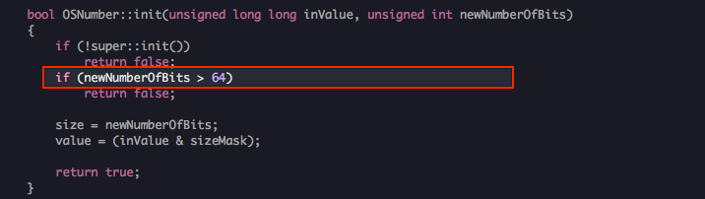
OSNumber bug 2: XML mode of OSUnserializeXML
Seems apple noticed the issue very soon, and fixed in iOS 10.1
This time they decided to fix the issue in OSNumber implementation
    During OSNumber initialization, newNumberOfBits cannot exceed 64

Slide 18
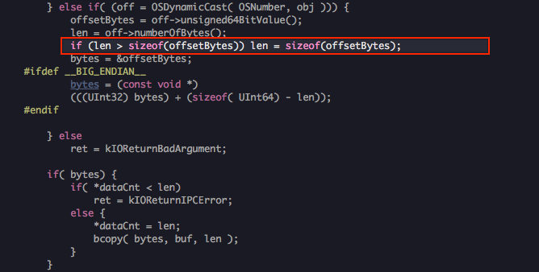
OSNumber bug 2: additional fix
Add check in is_io_registry_entry_get_property_bytes, dual protection!
    len cannot exceed 8 bytes

Slide 19
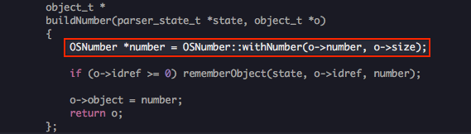
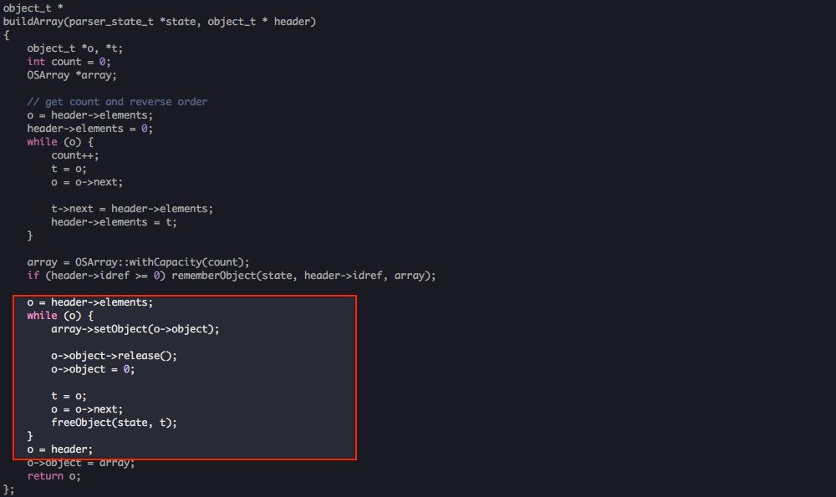
OSNumber bugs: all sorted?
In XML mode, if size > 64, panic will occur
Null pointer dereference
    After the leak was fixed, OSNumber::withNumber returns Null for invalid len
    In following array initialization, its element object is traversed and object->release is called, causing null pointer dereference

Slide 20
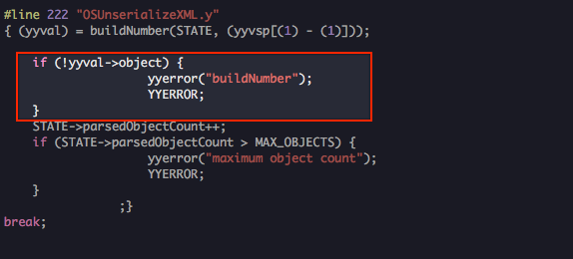
Final fix of OSNumber problem
Thoroughly fixed in iOS 10.2
    Check if OSNumber is created successfully

Slide 21
OOL Race Condition issue
Discovered by Qidan He of Keen Lab
Several drivers have the issue
    CVE-2016-7624
    CVE-2016-7625
    CVE-2016-7714
    CVE-2016-7620
Apple found 20+ bugs caused by this mechnism
When inputStruct length exceed 4096 in IOKit API IOConnectCallMethod will map the user mode buffer into kernel as the user input data:
    Both userland and kernelland virtual memory share the same physical memory
    Changing the content of the userlane buffer will change the kernel buffer content immediatel
    Causing race condition problems

Slide 22
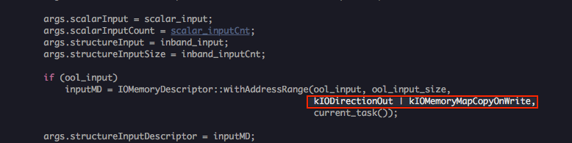
OOL Race Condition issue: the fix
Fixed in iOS 10.2
For all user supplied OOL buffer, map the kernel memory via Copy-On-Write

Slide 23
Part III: Exploitation

Slide 24
Object creation number limitation
Within sandbox several kernel objects can be created
    With various size, in various kalloc zone
    Perfect for heap fengshui
iOS 10 limits quite some kernel objects
E.g IOAccelResource2

Slide 25
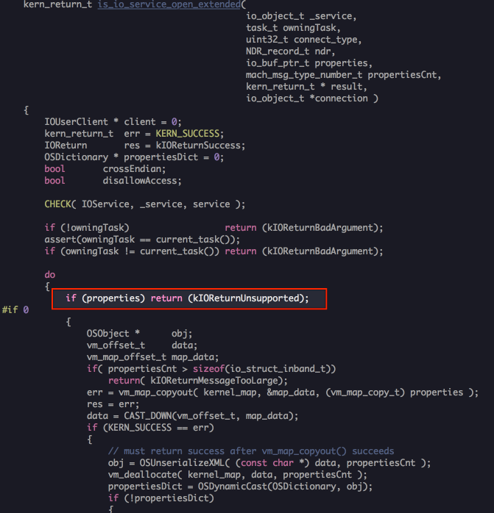
Simplify some "dangerous" interface
Famous API is_io_service_open_extended
    Accepts serialized user data and call OSUnserializeXML, pefect for heap fengshui
Simplified in iOS 10.2

Slide 26
Enhanced KPP/AMCC
From iOS 10.0 beta 2 got table is protected by KPP/AMCC
The approach in Pangu 9.3.3 to modify got table was prohibited
    PE_i_can_has_debugger
Luca iOS 10.1.1 AMCC bypass approach was fixed
    Can refer to Luca's talk: A Look at Modern iOS Exploit Mitigation Techniques

Slide 27
Neutering task_for_pid 0
Obtaining kernel task port has become a standard for Jailbreaks
Ian Beer mach_portal uses a very neat way to get tfp0
iOS 10.3 limits the use of tpf0
    Prohibit any usermode process to read/write kernel memory using tfp0
    Ian Beer's mach_portal approach is mitigated
iOS 11 extended the limit to the use of all task ports for app processes
    Ian Beer's userland port hijack approach is mitigated

Slide 28
SMAP on 64bit platform(iPhone 7 only)
Early in iOS 6, userland and kernelland address space are isolated
    Accessing userland memory in kernelland is prohibited
But on ARM64, only SMEP is present
    Disallow executing userland code in kernelland
    Kernelland can still access userland memory
Provide convenience on ARM64 kernel exploitation
    Leaking kernel heap address is not necessary
    E.g Both Pangu 9.3.3 jailbreak and Yalu102 attempt to access userland memory in kernelland
iPhone 7 prohibits userland memory access in kernelland
    Higher requirement on kernel info leak bug

Slide 29
Part IV: Summary

Slide 30
Summary
This year in iOS 10, Apple enhanced iOS kernel security a lot
Bus within container sandbox are almost extinct
    future jailbreaks need to chain exploits on sandbox bypass + out-of-sandbox kernel bugs
For some typical bugs, Apple tend to fix via mechanism instead of bug itself, to eliminate the whole set of problems
Apple actively mitigates some common exploit techniques, making kernel exploitation harder

Slide 31
One more thing…

Slide 32
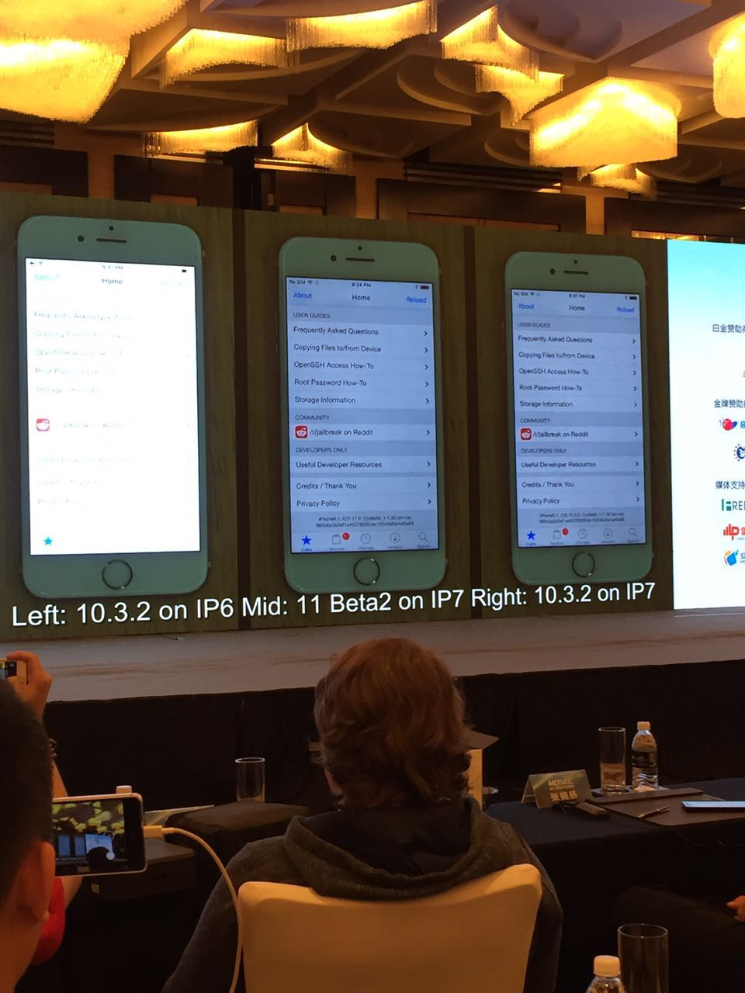

Slide 33
Thank you!

